Slide 1
Teaching Recursion

Slide 2
Role in Course
Recursion presents students with what is likely a new way of thinking about how to solve problems, and provides an early first look at an advanced topic that they will see again if they pursue computer science after high school.
Can be looked at essentially in isolation from the other outcomes in the course.
Intent for this outcome is a first look at the topic.
1-2 weeks would be an appropriate amount of time, depending on what projects are chosen for students to complete.

Slide 3
How it works – first day lesson
I introduce this topic with a short presentation / lesson, paired with some code-along simple recursive problems.
We’ll take the next 15 minutes to go through this lesson as it would be shared with a class.
If you are already quite familiar with recursion, you may want to jump ahead to solve some practice exercises on your own: www.codingbat.com/java/Recursion-1 www.codingbat.com/python/Recursion-1
Will have students complete several coding bats exercises as a first assignment.
Notes:
After this slide, switch over to Recursion - In Class Lesson.pptx and work through as a group.

Slide 4
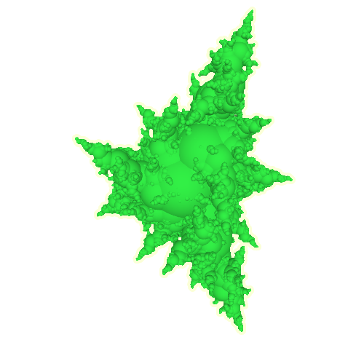
Recursive Visualizations
Fractals

Slide 5
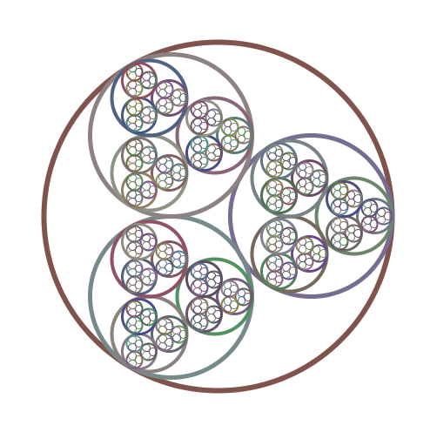
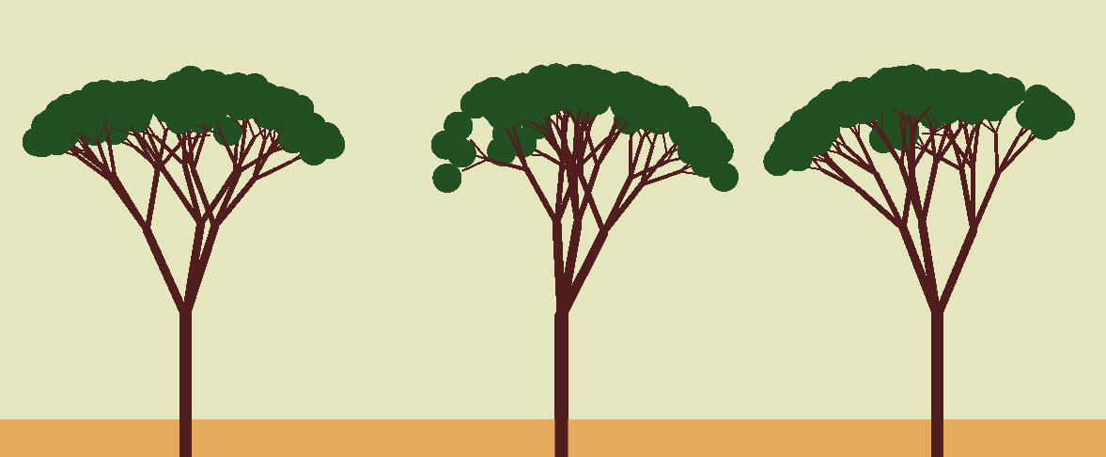
Fractals
On a third or fourth day, we spend a class introducing fractals, and create a few as a class.
Fractals are complex abstract geometric images, that exhibit self-similarity.
Can be expressed as a set of production rules, then articulated in a recursive function.
Notes:
Add so

Slide 6
Production Rules - Demo
Before any code is created, fractal images can often be expressed in plain language as a set of production rules.
As an example:
Create a circle.
At the leftmost point of that circle, create another circle that is half of the original circle’s size.
At the rightmost point of that circle, create another circle that is half of the original circle’s size.
These rules can be applied recursively; for each circle, two more (smaller) circles should be created.
Daniel Schiffman has a good video walking through creating production rules and fractals. An in-class demo could easily be modelled after this video. (8.2 Fractal Recursion – The Nature of Code)
Notes:
At this point, use Processing to quickly create the fractal above.
Add a bottom circle to expose Sierpinski’s Triangle

Slide 7
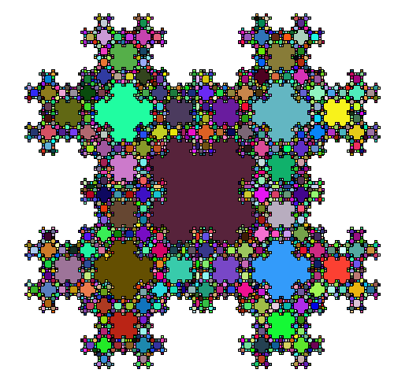
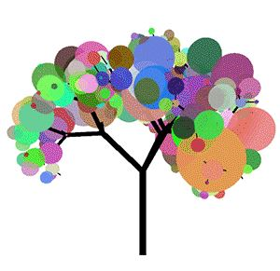
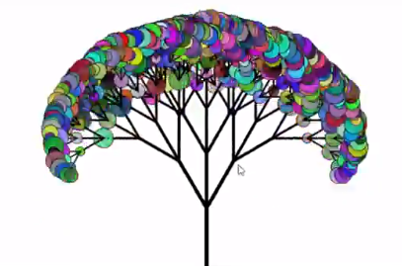
Possible Projects
Create-a-Fractal
Extend beyond an in-class demo of creating fractals.
Students create a set of production rules for a fractal, then code it
2D or 3D
~2 classes time usually given
Tree Creation
If more time available: Balloon Tree
If less (1 class) – Open “Finest Tree” project.

Slide 8
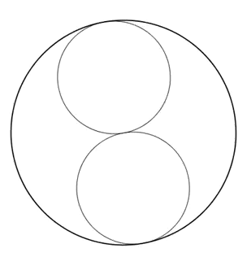
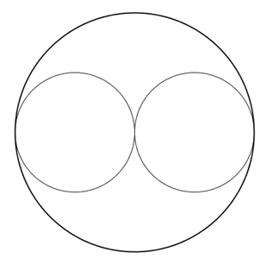
Possible Projects
3. Circle Pack Fractal
Added as a additional challenge for students who are working ahead.
Create a fractal where each circle has n circles packed inside so that each inner circle is tangent to its neighbours and the larger circle.
Depending on a student’s math proficiency, this may be very difficult to solve. Some hints/scaffolding have been compiled to help if the student is stuck.

Slide 9
Time to Explore
Carry on with some Recursion Practice on Coding Bat www.codingbat.com/java/Recursion-1 www.codingbat.com/python/Recursion-1
Look at the Fractals Assignment Details (Create-a-Fractal, Tree Assignments, Circle Pack Challenge), and try one out.
Discuss thoughts / ideas with your neighbours.

